Slide 1


What is React?
Developed by face book
JavaScript library created by Facebook to create UI
Use to make a single page application
It allows us to create reusable UI components

Slide 2
How to install React?
apps needed : Node JS /NPM, VS code, react install
Commands:-
npm install -g create-react-app
npx create-react-app my-app-name

Slide 3
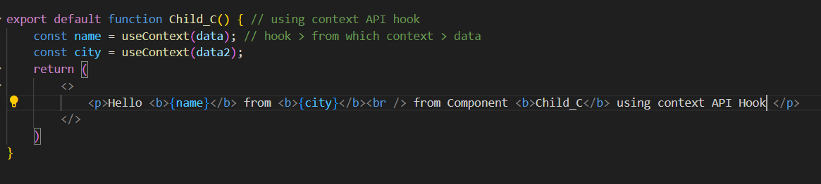
JSX
Stands for JavaScript XML
Class == classname
<br />, <img /> each void tag should be closed
Must wrap into one top level element wrapper
Js wrapped in {}

Slide 4

Things to Learn in Props
Passing / Receiving/ Accessing Props in JSX
Prop Types & Default Props
Passing Functions as Props
Spread attributes
Children Props
Conditional rendering based on props
Callback props
Pure Components and Memoization
State vs. Props
Pure Components and ShouldComponentUpdate
Destructuring Props
Read-Only Nature
Prop Drilling
Debugging props
Immutable Props (Props are read-only)
Context API
Higher-Order Components (HOCs)

Slide 5
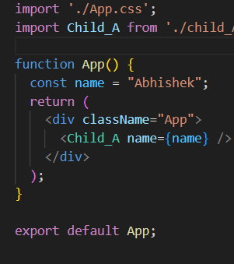
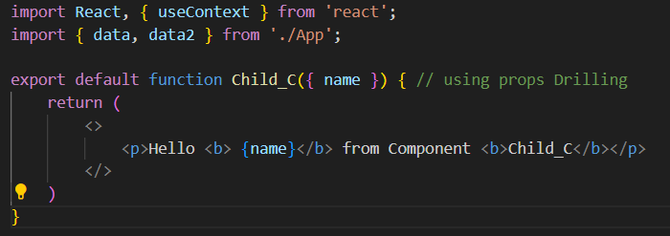
Passing/ Receiving/ Accessing Props in JSX
What are props?
Stands for properties
Used to transfer data from 1 component to another component
Props are Read only (immutable)
Props is just like function in JavaScript (act like arguments or parameters)

Slide 6
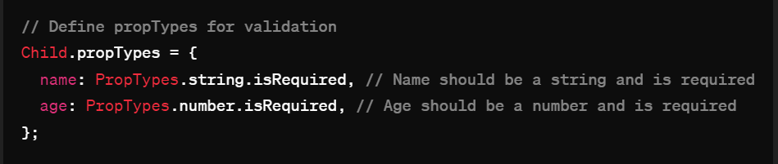


PropTypes
way to validate the props passed to a component

Slide 7
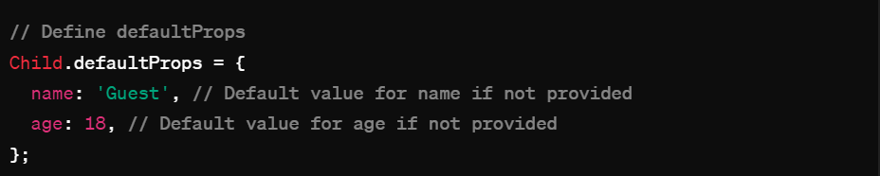
Default Props
allows us to specify default values for props

Slide 8
Passing Various types of Props
String
Numbers
Arrays
Objects
Functions
Passing JSX Elements

Slide 9
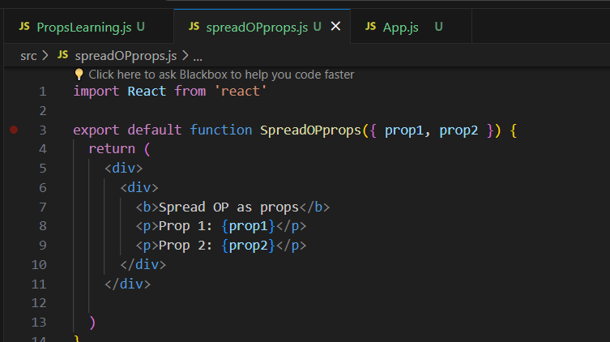

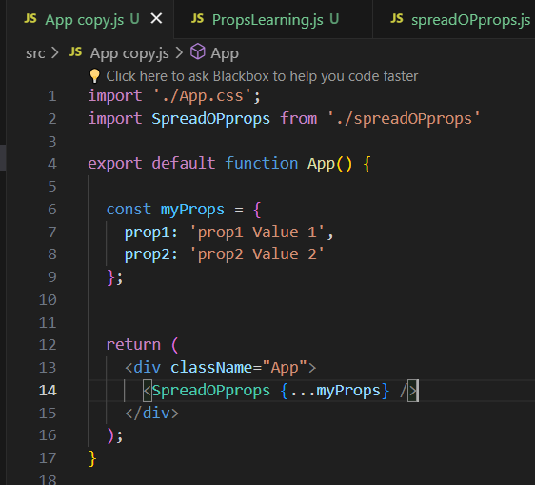
spread operator {...} to pass the props to the component

Slide 10
state
The state is a built-in React object that is used to contain data or information about the component.
A component's state can change over time; whenever it changes, the component re-renders.
In React, the term "state" refers to an internal data storage mechanism within components.
It allows components to manage and store data that can change over time
State enables React components to dynamically update and render UI elements in response to user actions, data fetching, or other events.
State represents the data that a component manages and can change over time, influencing the component's rendering

Slide 11
Things to learn about state
Stateful vs. Stateless Components
State Initialization
State Updates
Rendering Based on State
State Immutability
Derived State
Conditional Rendering with State
Event Handling with State
Passing State as Props
Managing Form State
Asynchronous State Updates
Local vs. Global State
Error Handling with State
State and Lifecycle Methods
State Management Patterns
Performance Optimization

Slide 12
Things to Learn in State
Event Handling and State Updates
State Management Fundamentals
Class Components vs. Functional Components
State Initialization
Updating State
State and UI Rendering
Immutable State
Passing State as Props
Managing Complex State
Handling User Input
Context API and State Management Libraries

Slide 13
State Initialization
"state" refers to an internal data structure within a component that allows the component to manage and keep track of its own data. State represents the current state of the component, including any information that can change over time.
In functional components, state is initialized using the useState Hook.
for class components within the constructor ()

Slide 14
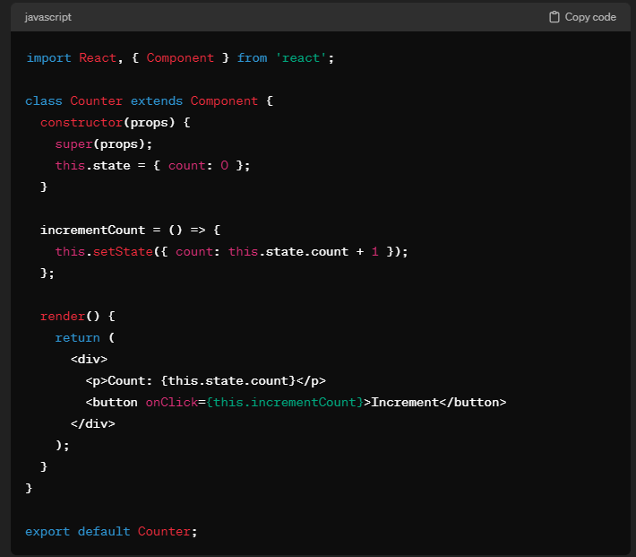
Stateful Components:
Also known as Class Components
stateful components can maintain and manage their own internal state.
They are created using ES6 classes and extend the React.Component class.
Stateful components have a state object which

Slide 15
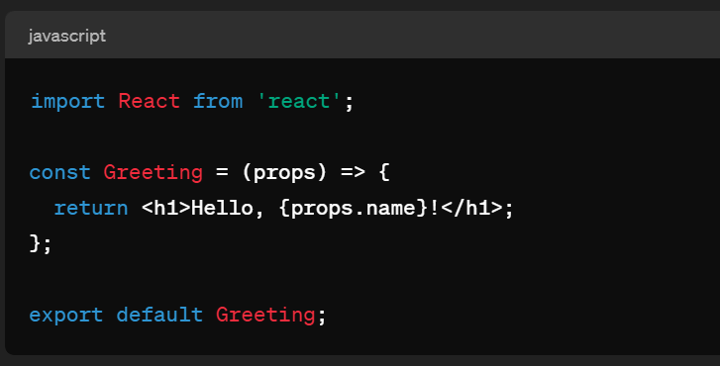
Stateless Components
Also known as Functional Components
stateless components are pure functions that receive props as input and return JSX
They do not manage their own state and are commonly used for presenting UI based solely on input props.
Stateless components are simpler, more lightweight, and easier to understand compared to stateful components.
They are preferred when the component doesn't need to manage state or lifecycle methods.

Slide 16
state initialization
state initialization can be done in two main ways: using class components or using functional components with hooks
state initialization can be done in two main ways: using class components or using functional components with hooks

Slide 17
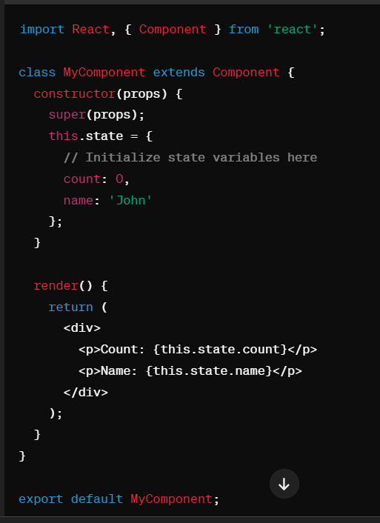
class components (Initializing State)
In class components, state is initialized within the constructor using this.state:

Slide 18
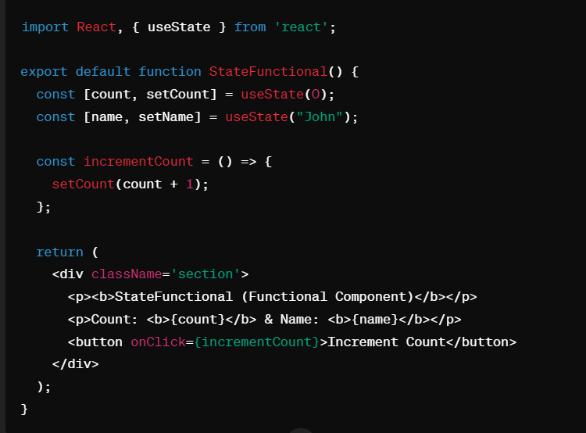
functional components (Initializing State)
In functional components, you can use the useState hook to initialize state:

Slide 19
State Updates
state updates are fundamental for managing component data and triggering re-renders.
There are primarily two ways to update state:
using setState (for class components)
using state hooks (for functional components).

Slide 20
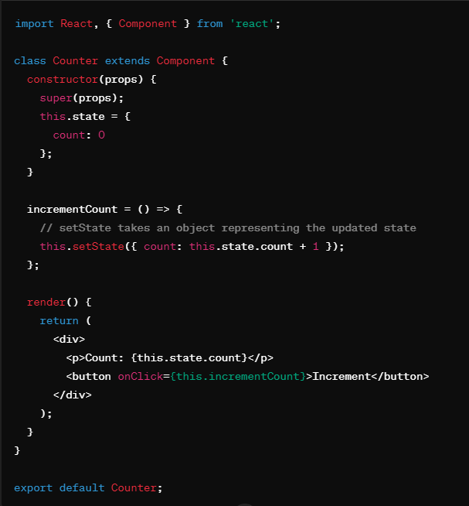
Class Components (State Update)
In class components, state is managed using the setState method. Here's a typical usage: components)

Slide 21
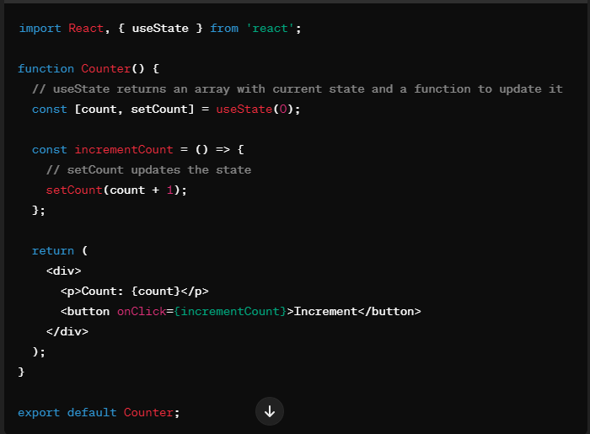
Functional Components (State Update)
Using Hooks
Functional components use state hooks such as useState to manage state:

Slide 22
Rendering Based on State
Rendering based on state in React involves conditionally displaying different content or components depending on the current state of your application
You can achieve this using conditional rendering techniques such as
if statements
ternary operators
logical && operators.

Slide 23
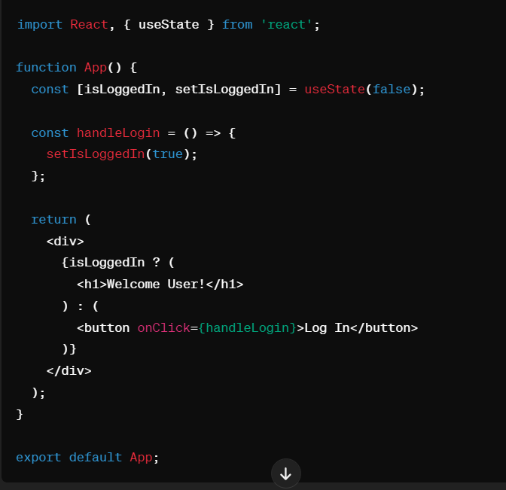
Using if statement/ ternary operators
condition ? exprIfTrue : exprIfFalse

Slide 24
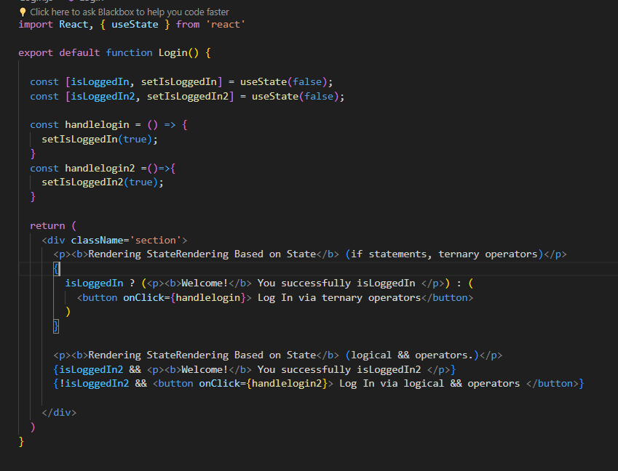
Using logical && operator

Slide 25
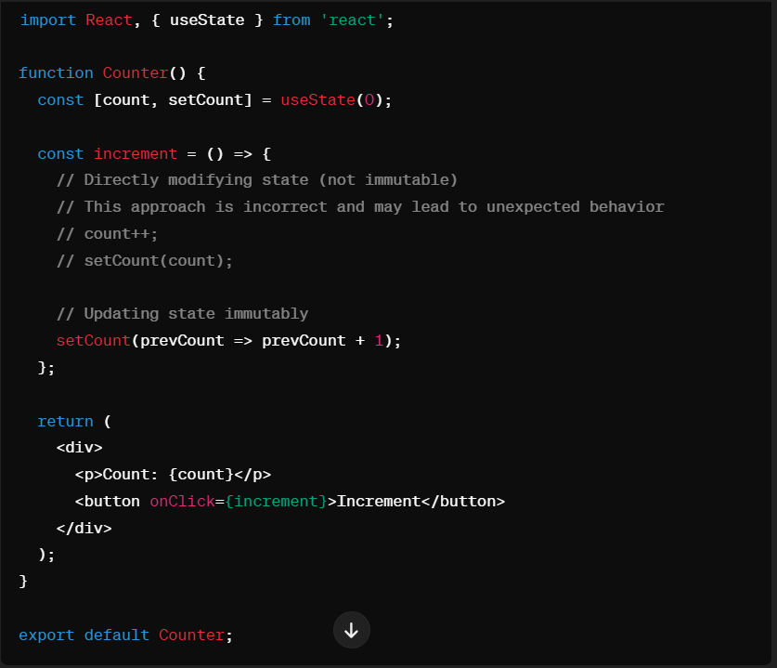
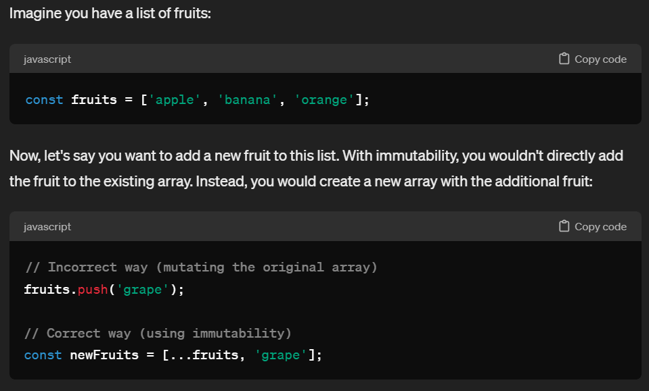
State immutability
State immutability in React is the practice of updating state by creating a new state object with modified values, rather than directly modifying the existing state object
not changing data directly, but instead creating new copies of the data when you want to update it
This ensures that the original data remains unchanged

Slide 26
why immutability is important
Predictable State Changes: With immutable data, you can easily track changes to your data over time. This makes it easier to understand what's happening in your application and debug issues.
Avoiding Side Effects: Directly modifying data can lead to unexpected behavior, especially in large applications with complex data flows. Immutable data helps prevent these side effects by ensuring that data remains consistent throughout your application.
Performance Optimization: React uses a process called "reconciliation" to determine when to update the UI based on changes in state. Immutable data makes this process more efficient because React can quickly determine if a piece of data has changed by comparing references.
Facilitating Component Reusability: Immutable data makes components more reusable because they don't rely on external factors that might change their behavior. This makes it easier to reason about and reuse components in different parts of your application.

Slide 27
Derived State
Derived state refers to a value calculated from existing state or props within a component. It's a way to avoid storing redundant data or logic in your component's state.
Derived state involves computing a state value based on other state or props.
Identify the state value that will be derived based on other state or props.
Ensure that the derived state function is called whenever the dependent state or props change.

Slide 34
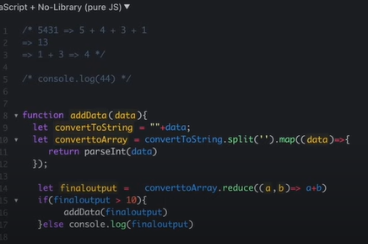
JavaScript Questions

